Slide 1
Growth Mindset day 1
Room 123

Slide 2

Find as many ways as you can to group the following dots.

Slide 3
How would you describe a circle to someone who doesn’t know about shapes?

Slide 4
Video
https://bhi61nm2cr3mkdgk1dtaov18-wpengine.netdna-ssl.com/wp-content/uploads/2017/06/Day-1-Mindset-8.mp4

Slide 5
Four 4’s Activity
Groups of 3 – 4
Create a list from 1–20 in which you use four 4s and any math operation

Slide 6
1 11
2 12
3 13
4 14
5 15
6 16
7 17
8 18
9 19
10 20

Slide 7
Can you use Four 4’s to make negative numbers?
How many number’s can you create with Five 5’s?

Slide 8
Reflection (10 - 12 minutes) (write a few down on your board)
What things do you like people to say and/or do when you are working on a math problem in a group?
What things do you not like people to say and/or do when you are working on a math problem in a group?

Slide 9
Video
https://bhi61nm2cr3mkdgk1dtaov18-wpengine.netdna-ssl.com/wp-content/uploads/2017/07/Day-2-Brain-Crossing.mp4

Slide 11
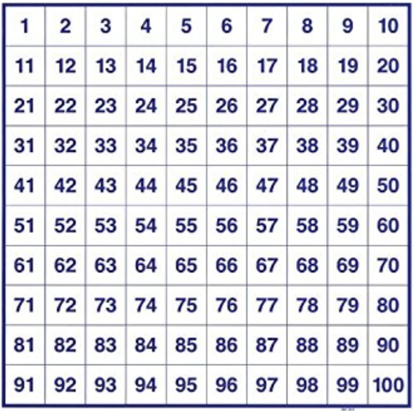

Slide 12
Exit Ticket
What do you want me to know about you in order to make this year the best year you’ve had in a math classroom?

Slide 13

What about the following?

